Slide 1

Retrospective

Slide 2

Scrum is empirical process
Inspection
Adaption
Transparency

Slide 3
Purpose
Drive toward continuous improvement by
Gather feedback on
What worked
What didn’t
What could improve things

Slide 4
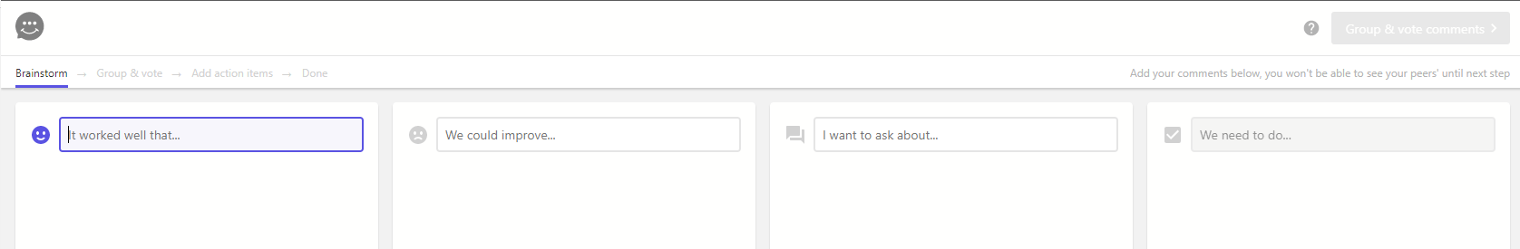
Retro tool
https://retrotool.app/
Its free it work and it pretty good

Slide 5
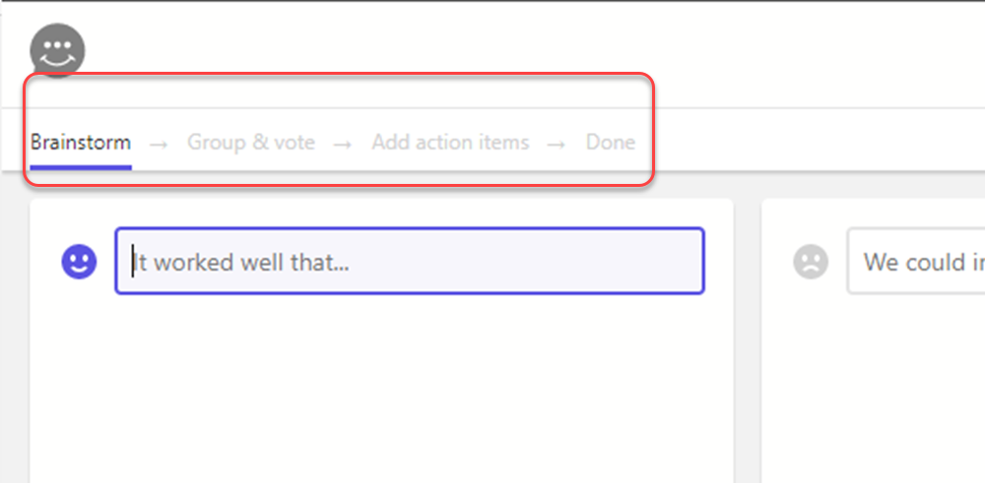
Four phases
Brainstorm
Group & Vote
Add action item
Done

Slide 6
Feedback categories
What worked?
Teams
Tools
Teacher
What didn't work?
Teams
Tools
Teacher

Slide 7
“Rules”
Open
Respectful
Don’t mention others by name (e.g. Tim didn’t complete work item 64)
Be ready to suggest fixes
6 votes (total for three columns)

Slide 8
Sharing info
Please share the outcomes from the previous retro in the current sprint review

